Slide 1
Specialty Populations: Lessons from Critical Care Research
BIDMC Human Subject Protection Office
Clinical Research Team Rounds
January 8, 2014
Valerie Banner-Goodspeed

Slide 2
Conflicts of Interest
None to declare

Slide 3
Today’s Topics
Logistics
Study Team
Medical Team
Substitute Decision Makers
Who
How
Regulatory Considerations
Recruiting & Consenting Plan
Safety Reporting Plan
Source Documentation
Working with the EMR
Components of severity of illness scores

Slide 4
Critical Care Research: Landscape
Patients are acutely ill
Often intubated, sedated, incapacitated
Substitute decision makers:
May or may not be identified / reachable
If located, are often in high-stress state
Implications: environment is poor fit for typical patient-driven-consent research trials
Many interventions for critical illness are not supported by randomized clinical trial data, or RTC data is inconclusive

Slide 5
Critical Care Research: Solutions
Pre-identification of patients
Emergency department (acuity threshold)
Pre-op for cases that go to ICU post-op
Consenting plans that rely on proxies
Primary outcome: mortality
Secondary outcome: biomarkers, indicators of clinically relevant status (organ dysfunction, cognitive status)
Long-term outcomes: relatively new but important

Slide 6
Critical Care Research: Logistics
Internal – study team management
External – working with hospital staff

Slide 7
Critical Care Research: Logistics
Study Team
Problem: Unpredictability of patient arrival and/or when patient will meet entrance criteria.
Solution: Extended shifts to cover evening / weekends
Solution: Involve medical trainees
Human subjects research training
Work closely with study team

Slide 8
Critical Care Research: Logistics
Medical Team: Buy-in
Problem: Acuity of patient means high stakes, high stress, multiple specialties involved
Solution: Extensive in-servicing in ICUs prior to study start, and throughout study
Solution: Recruit physician investigators from relevant areas – preferably ones in a position to advocate for the study

Slide 9
Critical Care Research: Logistics
Medical Team: Continued Support
Problem: New team at each shift change, who may or may not buy into study plan (or be aware of it)
Solution: Signage! On door of ICU, on whiteboard in room, research consent note in EMR, staff flyer in patient’s bedside chart
Note: anything that could reasonably be viewed by patient/family must be IRB-approved prior to posting
Solution: Frequent contact. E.g. emails to respiratory therapy group with 24-hr plan; team check in after rounds; just-in-time education

Slide 10
Critical Care Research: Logistics
Medical Team: Continued Support
Problem: Working with RN, RT, MD, LICSW
If the protocol standardizes many aspects of care, this will require cooperation from different groups of providers
Solution: In-service all groups prior to study start
Solution: Stay in touch. Know the unit coordinators, know the RT shift supervisors, know the resource nurses. Check in when planning to recruit a patient, follow up during patient’s stay.
Research will always be secondary to clinical care. Plan protocol to coincide as much as possible with clinical care – yields better protocol compliance, better cooperation

Slide 11
Critical Care Research: SDM
Who can be a substitute decision maker?
What about patient consent?

Slide 12
Critical Care Research: SDM
Who can give consent?
Legally Authorized Representative
Legally appointed guardian
Healthcare proxy
Next of kin
Guided by an understanding of what the patient would want; if unknown, decides what is in the patient’s best interest.
Use of LAR must be IRB-approved

Slide 13
Critical Care Research: SDM
Who can give consent?
Problem: Patient is new to BIDMC, EMR is sparse. No guardianship on file, no HCP paperwork on file. Who can the study team approach?
Solution: Whomever is making clinical decisions on behalf of the patient. Social work notes often have best family contact information. Nurses are often best source for perceived family dynamics.

Slide 14
Critical Care Research: SDM
Re-consent
The patient’s consent is still the ultimate goal
Must have plan for and documentation of daily assessment of patient’s capacity to engage in a consenting discussion
Typical questions to assess capacity:
Do you have to continue in this study? (voluntariness)
Can you describe what this study is about? (purpose/procedures)
Can you describe the pros and cons of being in the study? (risks/benefits assessment)

Slide 15
Critical Care Research: Regulatory
Recruiting & Consenting
Safety Reporting Plan

Slide 16
Critical Care Research: Regulatory
Recruiting & Consenting
CCI application Part B / section B6
Recruitment by phone
Use of SDM
Plan for continuing consent
Remote consenting

Slide 17
Critical Care Research: Regulatory
Recruiting & Consenting
Sample Language: CCI application part B / section B6
Consent
Once a patient is deemed eligible for the study the family or other designated health care proxy will be approached to give informed consent for participation in the trial. (Due to the nature of critical illness and the fact that all subjects will be undergoing mechanical ventilation generally under heavy sedation, most patients will not be able to give consent themselves). If a patient regains capacity during the course of the trial, they will be approached for continuing consent by a qualified member of the study team.
In the event a patient is unable to give consent, and proxy consent is required, we may contact the proxy by phone to gauge interest in the trial. If the proxy is interested, we will try to schedule a time for them to come to the hospital to meet with study personnel. If the proxy is unable to get to the hospital in the time window required per protocol, we will ascertain if the proxy is able to receive and send faxed documents or scanned documents by email. If the proxy can provide written consent via either of these methods, we will proceed with the consenting process. We will discuss the study in depth by phone (please see the phone script provided). If the proxy choses to consent to the trial over the phone, we will document this in full, and arrange to capture the proxy’s signature on the consent forms by fax or scanned PDF sent via email. We will provide all written materials (written consent form, patient handout) to the proxy electronically. In no circumstance will we proceed with an enrollment if the proxy cannot return a signed consent form to us.

Slide 18
Critical Care Research: Regulatory
Recruiting & Consenting
Supporting Documents
Consenting memo: relationship of proxy to patient, why proxy was needed. Mode of conversation (if by phone)
Daily assessment sheet: patient capacity, changes to consent status
If/When able to re-consent: second consenting memo

Slide 19
Critical Care Research: Regulatory
Recruiting & Consenting
Example of Consenting Memo
I, (Dr.) ____________ have spoken with SUBJECT/PROXY about participating in the study. (IF THE PATIENT IS UNABLE TO GIVE CONSENT, EXPLAIN WHY) _________________
I explained the study and reviewed the consent form with _________ (full name, relationship to subject). I provided HIM/HER the opportunity to ask questions about the study and have them answered by ___________. Specific issues addressed include _________________ _____________________________. We discussed alternative options and reviewed risks and benefits of the study. Through the course of this discussion I was able to assess the PATIENT/PROXY has an adequate understanding of the study.
The PATIENT/PROXY has agreed to take part in the study and understands that HE/SHE may withdraw at any time. The consent form was signed on _________(DATE and TIME), prior to the start of study interventions. The signing was witnessed by ___________, a third party unrelated to the study team. A copy of the consent was placed in the Medical Record and a copy was given to the PATIENT/PROXY. The original signed Informed Consent Form is in our research files.

Slide 20
Critical Care Research: Regulatory
Recruiting & Consenting
Example of Daily Assessment Sheet
Consent Change? If YES Patient able to give continuing consent? If yes, consent given or withdrawn? Proxy change to consent? | ❑ Yes  No
Please document any of the above in a detailed memo to file including: | permitted | refused
ongoing protocol procedures | ❒ | ❒
ongoing specimen collection | ❒ | ❒
passive data collection | ❒ | ❒
contact for follow-up | ❒ | ❒
biorepository | ❒ | ❒
DNA analysis | ❒ | ❒

Slide 21
Critical Care Research: Regulatory
Recruiting & Consenting
Example of ICF Signature Page
CONSENT OF THE SUBJECT TO CONTINUE TO BE IN THE STUDY
Your legal representative gave his/her consent for you to be in this research study. This is because you were not able to make your own decision due to your illness. Your condition has now improved. You are being asked to decide whether to continue to be in this study. Your decision is voluntary. This means your decision is up to you.
You have read the information in this form and someone has explained to you what study procedures will be continuing. Your questions have been answered to your satisfaction. You believe and understand all of the information about this study.
❑ I have decided to continue taking part in this study.
❑ I have decided to STOP participating in this study and
Information gathered so far  CAN  CANNOT be used by the study doctor
Specimens collected so far  CAN  CANNOT be used for biomarker analysis
The study team  CAN  CANNOT contact me for follow-up information (1 month / 12 months)
Signature of Subject : ____________________________________________ Date: _________________
Signature of Investigator/Co-Investigator: ____________________________ Date: _________________
Printed name: ___________________________________

Slide 22
Critical Care Research: Regulatory
Safety Reporting Plan
CCI application Part B / section B3A
Limitations on scope of reporting
Proposed definitions: Expected/unexpected, serious categories
CCI application Part P
Risk category: critically ill population impacts risk
DSMP (including DSMB charter) must agree with safety reporting plan
Caveats:
Must be IRB-approved
Does not obviate responsibility for continual monitoring of patient safety
For IND studies, FDA safety reporting follows the usual (larger) scope

Slide 23
Critical Care Research: Regulatory
Safety Reporting Plan
Example of CCI application Part B / section B3A
Our patient population is by definition critically ill. It is expected that they will have a number of unrelated adverse health events during the course of their hospital stay. Therefore, we will limit the scope of our AE monitoring and recording to the following:
Serious Adverse Events, defined as
Death, believed to be related to the study medication or procedures, or a death that is unexpected considering the acuity of a patient.
A life threatening experience believed to be related to the study medication or procedures
Persistent or significant disability or incapacity that is of greater frequency or severity than what would be normally expected in the course of critical illness.
An event that jeopardizes the Human Subject and may require medical or surgical treatment to prevent one of the preceding outcomes and is not expected in the course of critical illness.
Non-Serious Adverse Events possibly related to the intervention or pre-specified in the list below:
New onset shock … etc.

Slide 24
Critical Care Research: Regulatory
Safety Reporting Plan
Example of CCI application Part B / section B3A
For the purposes of this study, locally and across sites, we will be defining Adverse Events in the following ways:
Unexpected: An Unexpected Adverse Event (UAE) is any Adverse Event and/or reaction, the specificity, severity, or frequency of which is not consistent with the informed consent, current investigator brochure or product labeling. Further, it is not consistent with the risk information described in the general investigational plan or proposal and informed consent document on file with the MCC, or is not consistent with what would be expected in a patient with critical illness.
Expected: Expected Adverse Events are those events that are included as a possible risk in the informed consent document or are expected in the course of care of a patient with critical illness.
Serious: An SAE is defined as death believed to be related to the study medications or procedures, or a death that is unexpected considering the acuity of a patient; or a life threatening experience, persistent or significant disability or incapacity that is of greater frequency or severity than what would be normally expected in the course of critical illness, or an event that jeopardizes the Human Subject and may require medical or surgical treatment to prevent one of the preceding outcomes and is not expected in the course of critical illness.

Slide 25
Critical Care Research: Regulatory
Safety Reporting Plan
Example of Daily Safety Check
Please review each calendar day for the following:
Withdrawal of support? Patient/family wishes to withdraw life support | ❑ Yes  No
[Specified events of interest] | ❑ Yes  No
Any other Adverse Events that are unexpected based on the patient’s clinical condition, or suspected to be related to trial participation? Describe: | ❑ Yes  No
PI Signature: ________________________ Date of review: ________
Notes:
be sure to have PI sign off on 24-hour events from clinical progress note as reviewed for relatedness to study

Slide 26
Critical Care Research: Source Documentation
Working with the medical record
Working outside the medical record

Slide 27
Critical Care Research: Source Documentation
Medical Record
Have a plan for where each data point comes from
Which medical record system? MetaVision, OMR, PIMS, POE
Which section?
Temporal resolution
Parameters, restrictions, exceptions
Hospital medical record should be used to fullest extent possible
Adding items to EMR: ask nurse/ RT

Slide 28
Critical Care Research: Source Documentation
Medical Record
Examples of SOP / annotated CRF

Slide 29
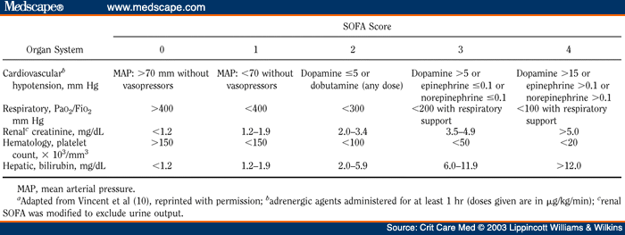
Critical Care Research: Source Documentation
Medical Record
Use charted clinical data for calculating severity of illness scores – make calculation transparent

Slide 30
Critical Care Research: Source Documentation
Medical Record
Adding items to the medical record
Administration of research drugs should be charted in MAR per standard nursing / RT practice
Charting vital signs at study-driven intervals can be arranged (discuss prior to study start with nurse manager)
Charting ventilator settings at study-driven intervals can be arranged (respiratory therapy supervisor)

Slide 31
Critical Care Research: Source Documentation
Bedside Data Collection
Some items are not captured in the medical record
Recurring research assessments
Specialized equipment output

Slide 32
Critical Care Research: Source Documentation
Bedside Data Collection
Record components of assessments: severity of illness composite scores, cognitive assessments, quality of recovery scores
Training of assessor should be documented/standardized

Slide 33
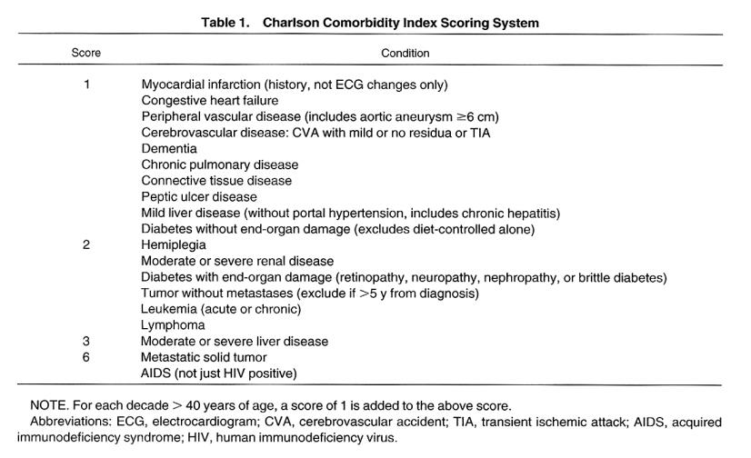
Critical Care Research: Source Documentation
Record components of assessments: severity of illness composite scores, cognitive assessments, quality of recovery scores
Training of assessor should be documented/standardized

Slide 34
Critical Care Research: Source Documentation
Bedside Data Collection
If using specialized equipment, be clear about operator, training.
Most equipment currently available has capability to store/export data. Work with manufacturer.
Reading off a display at bedside is last choice.

Slide 35
Critical Care Research: Transferrable Lessons
Plan protocol with clinical flow as much as possible
Engage clinical team. Educate, communicate.
Create detailed standard operating procedure for all aspects of study conduct: screening, consenting, data collection, file retention, drug/specimen/imaging requirements.
Annotate the case report form to define fields and sources.
Keep track of screening, consenting. Valuable for feasibility write-ups, CONSORT diagrams.

Slide 36
Thank you!
Any Questions?

